Slide 1
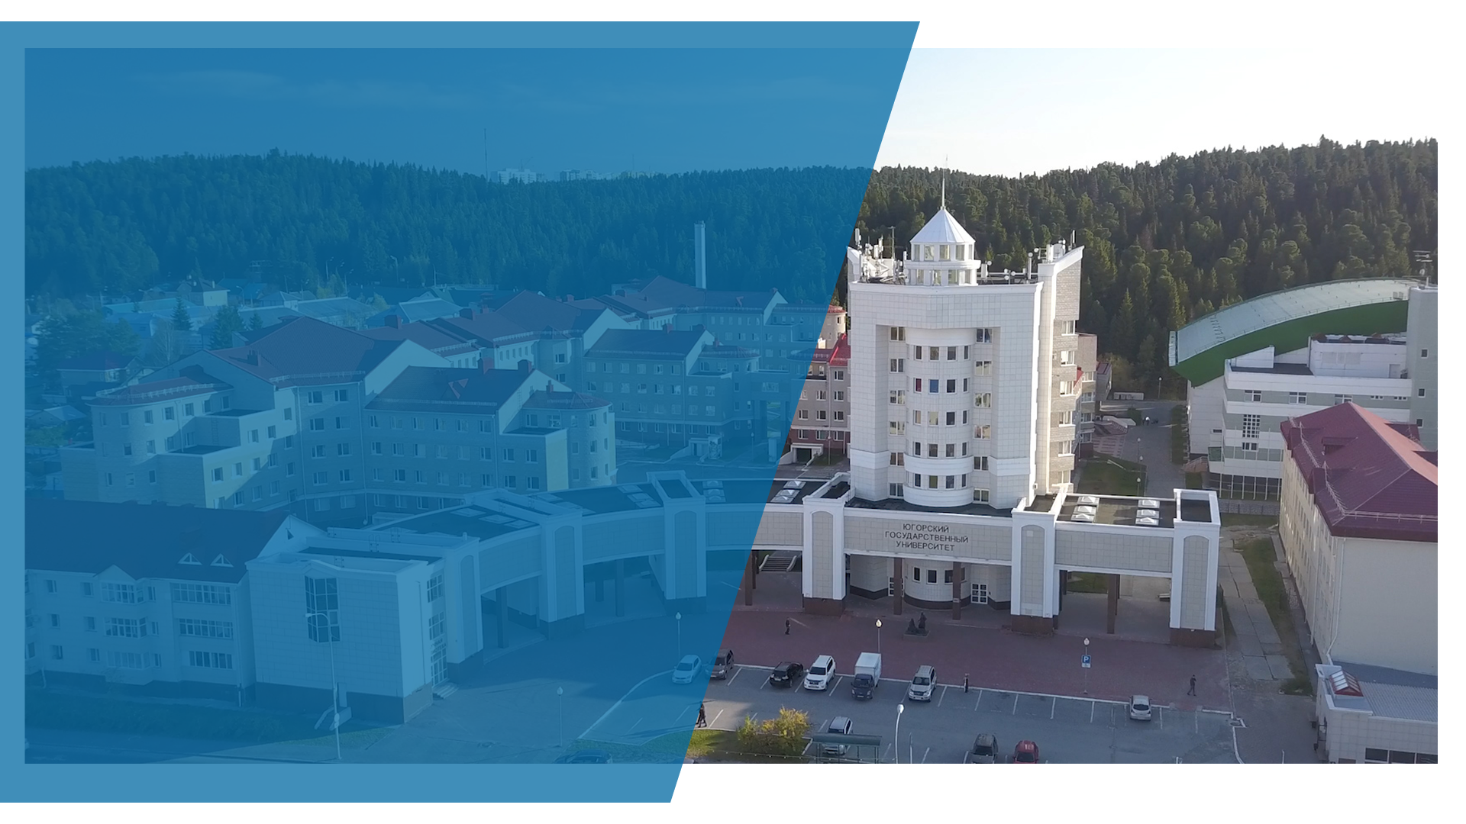

Yugra State University
Khanty-Mansiysk, Russia
priem@ugrasu.ru
ugrasu@ugrasu.ru
en.ugrasu.ru
Contacts:
ugrasu.international@ugrasu.ru, +79825544517

Slide 2

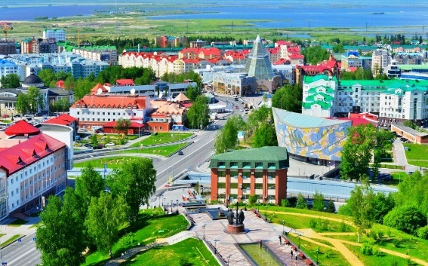
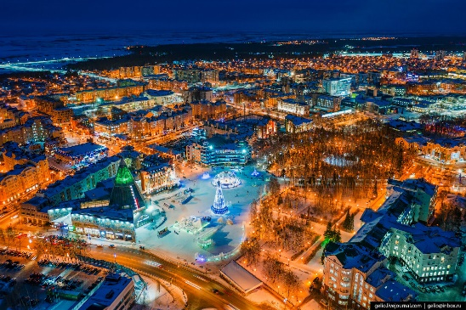
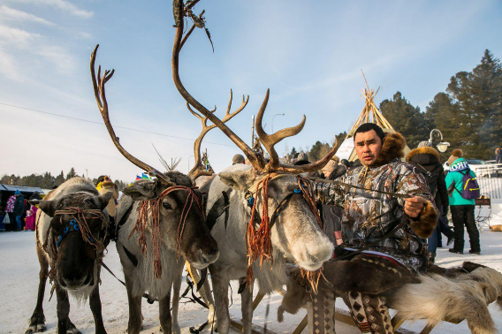
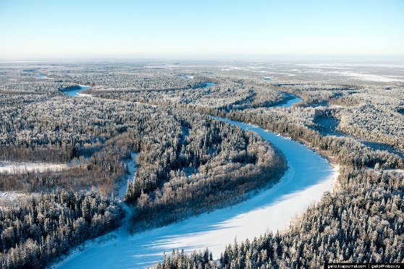
Khanty-Mansiysk Autonomous Okrug – Yugra is part of the Tyumen Region of the Russian Federation.
Yugra is an economically self-sufficient region, the main oil and gas producing region of Russia and one of the largest oil-producing regions in the world.
Its population is about 1.646 million people.
Yugra ranks 10th in the quality of life rating among Russian regions.
Khanty-Mansiysk is a modern and dynamically developing city, an important cultural and economic centre with many unique historical sites and protected natural areas, as well as a world-famous ski resort.

Slide 3
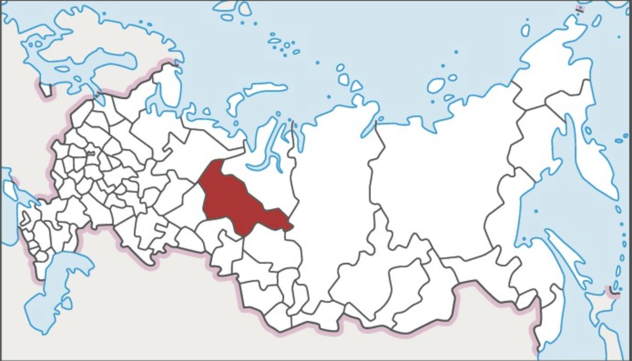
Yugra region on the map of Russia

Slide 4
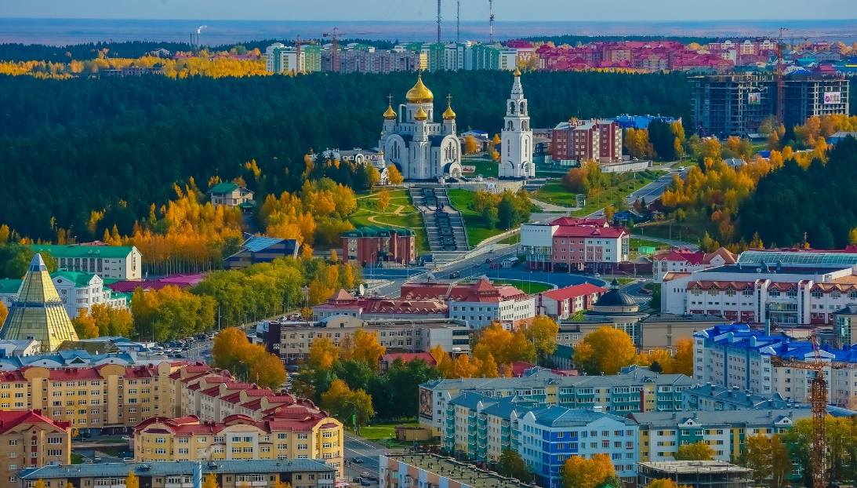
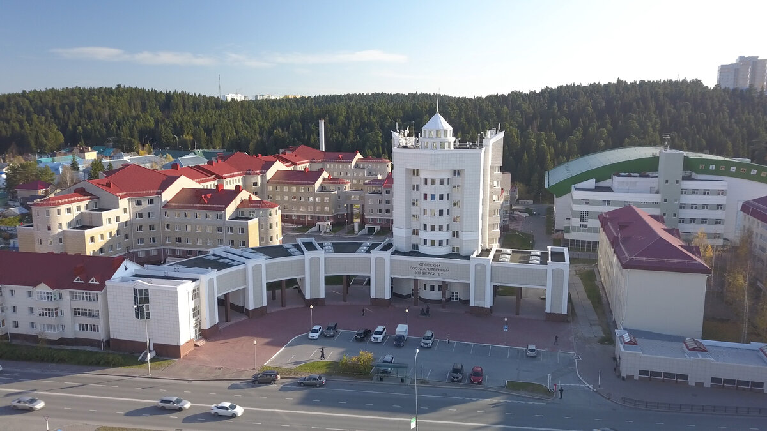
Khanty-Mansiysk
The capital of Yugra
Population – 110,000 people.
Modern, safe and comfortable city.
Sports capital: many venues for various sports;
Cultural capital – museums, galleries, cinemas, theatres, etc;
Host of international events: IT Forum, Spirit of Fire, Biathlon.

Slide 5


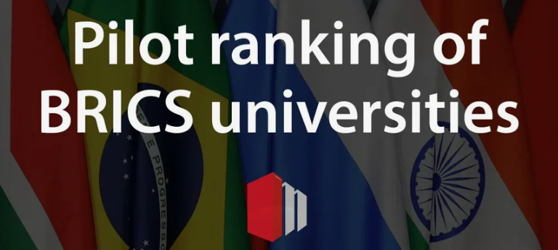



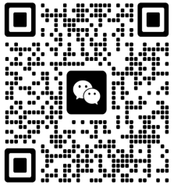
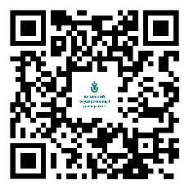
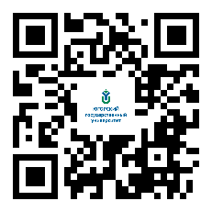
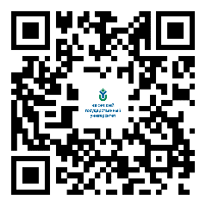
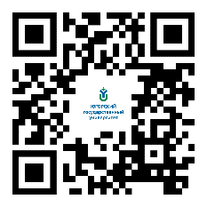
University in numbers
119
>10 000
136
>900
programs
students
postgraduates
staff
1501-1750
1437
451-500
136-139
83
Second league
WeChat
Telegram
VK
RuTube
OK
website： ugrasu.ru

Slide 6


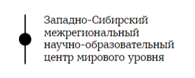












Partners of YuSU
Education and science
Oil and gas companies
IT
Government
Energy sector

Slide 7






Rossotrudnichestvo
International cooperation
40 partner universities
200 international students
6 foreign teachers
Collaborations
Partnerships
SecNet: Climate monitoring in Siberia
Russian-Asian Consortium for Arctic Research
AFUU: Association of Finno-Ugric Universities
Russian-African Network University
NEDRA: Professional community for training personnel for mining and raw materials complexes.
Rossotrudnichestvo

Slide 8
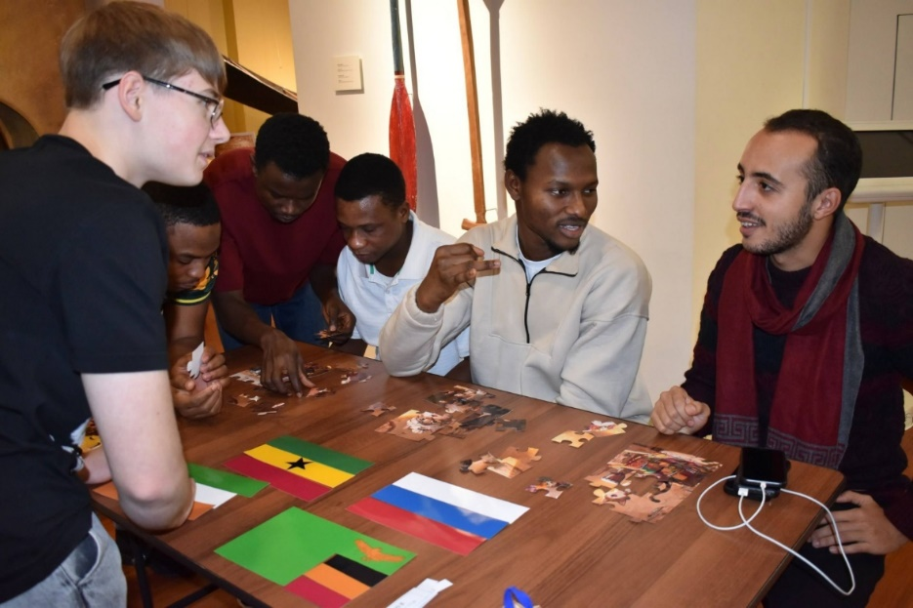
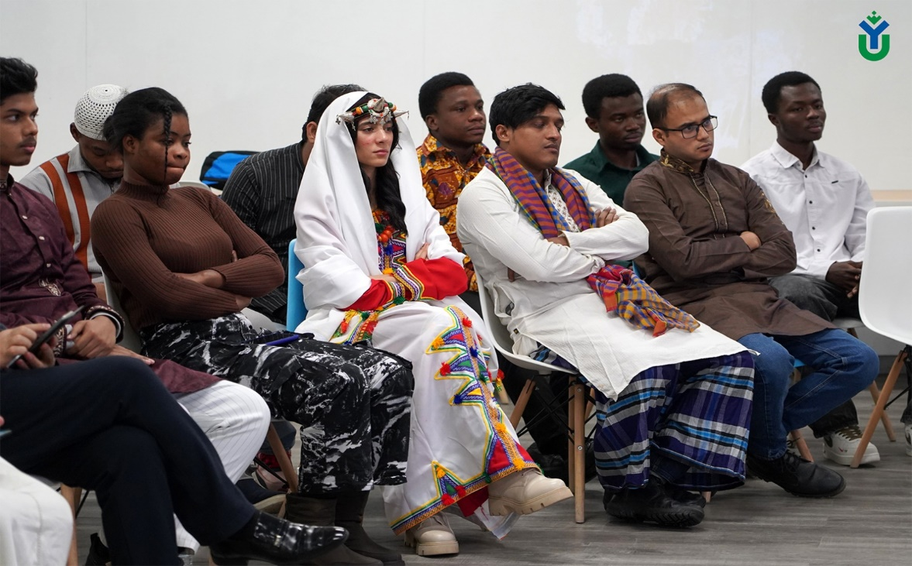
International students
11 countries
Kazakhstan
Tajikistan
Kyrgyzstan
Uzbekistan
Azerbaijan
Ghana
7. Egypt
8. Bangladesh
9. Turkmenistan
10.Colombia
Zambia

Slide 9
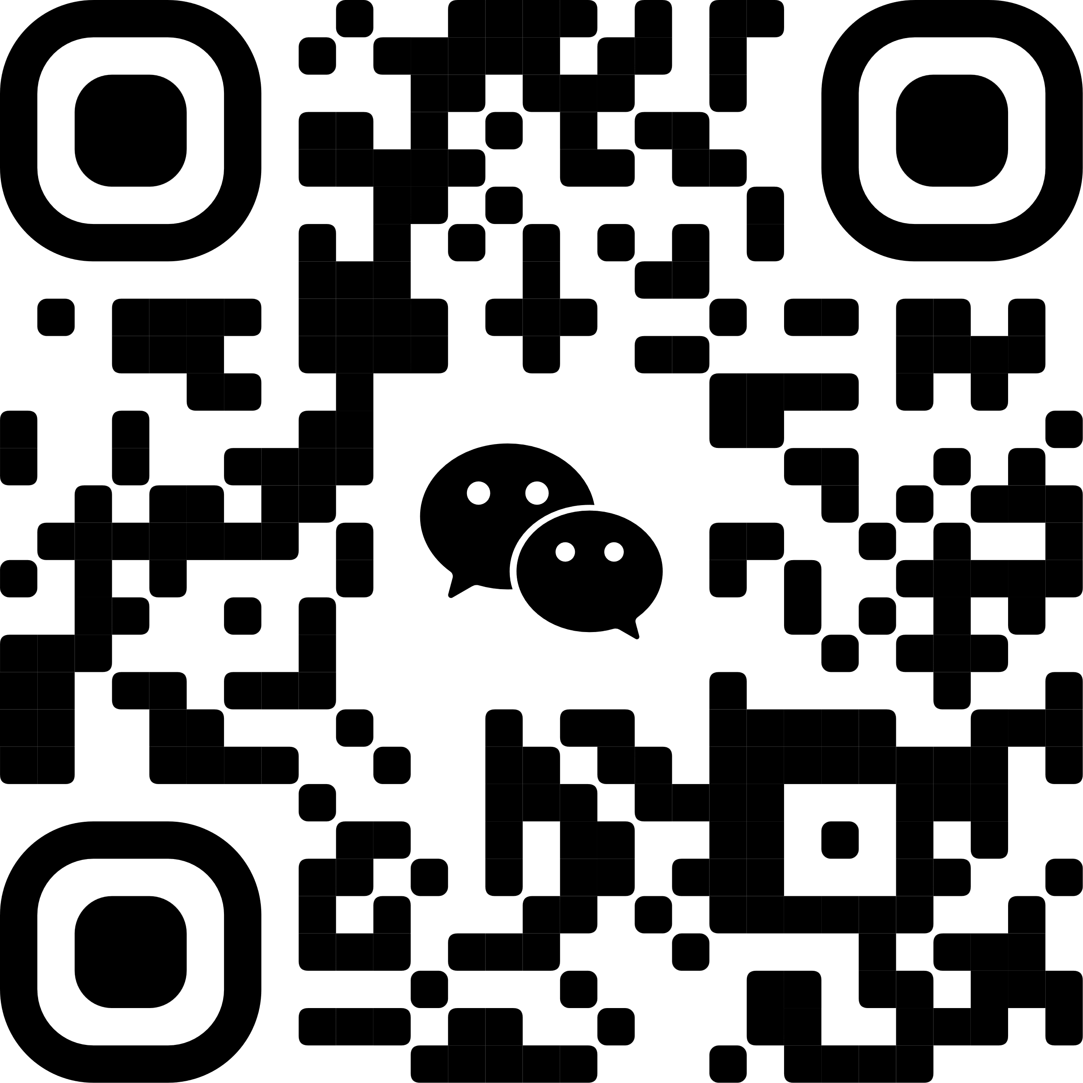
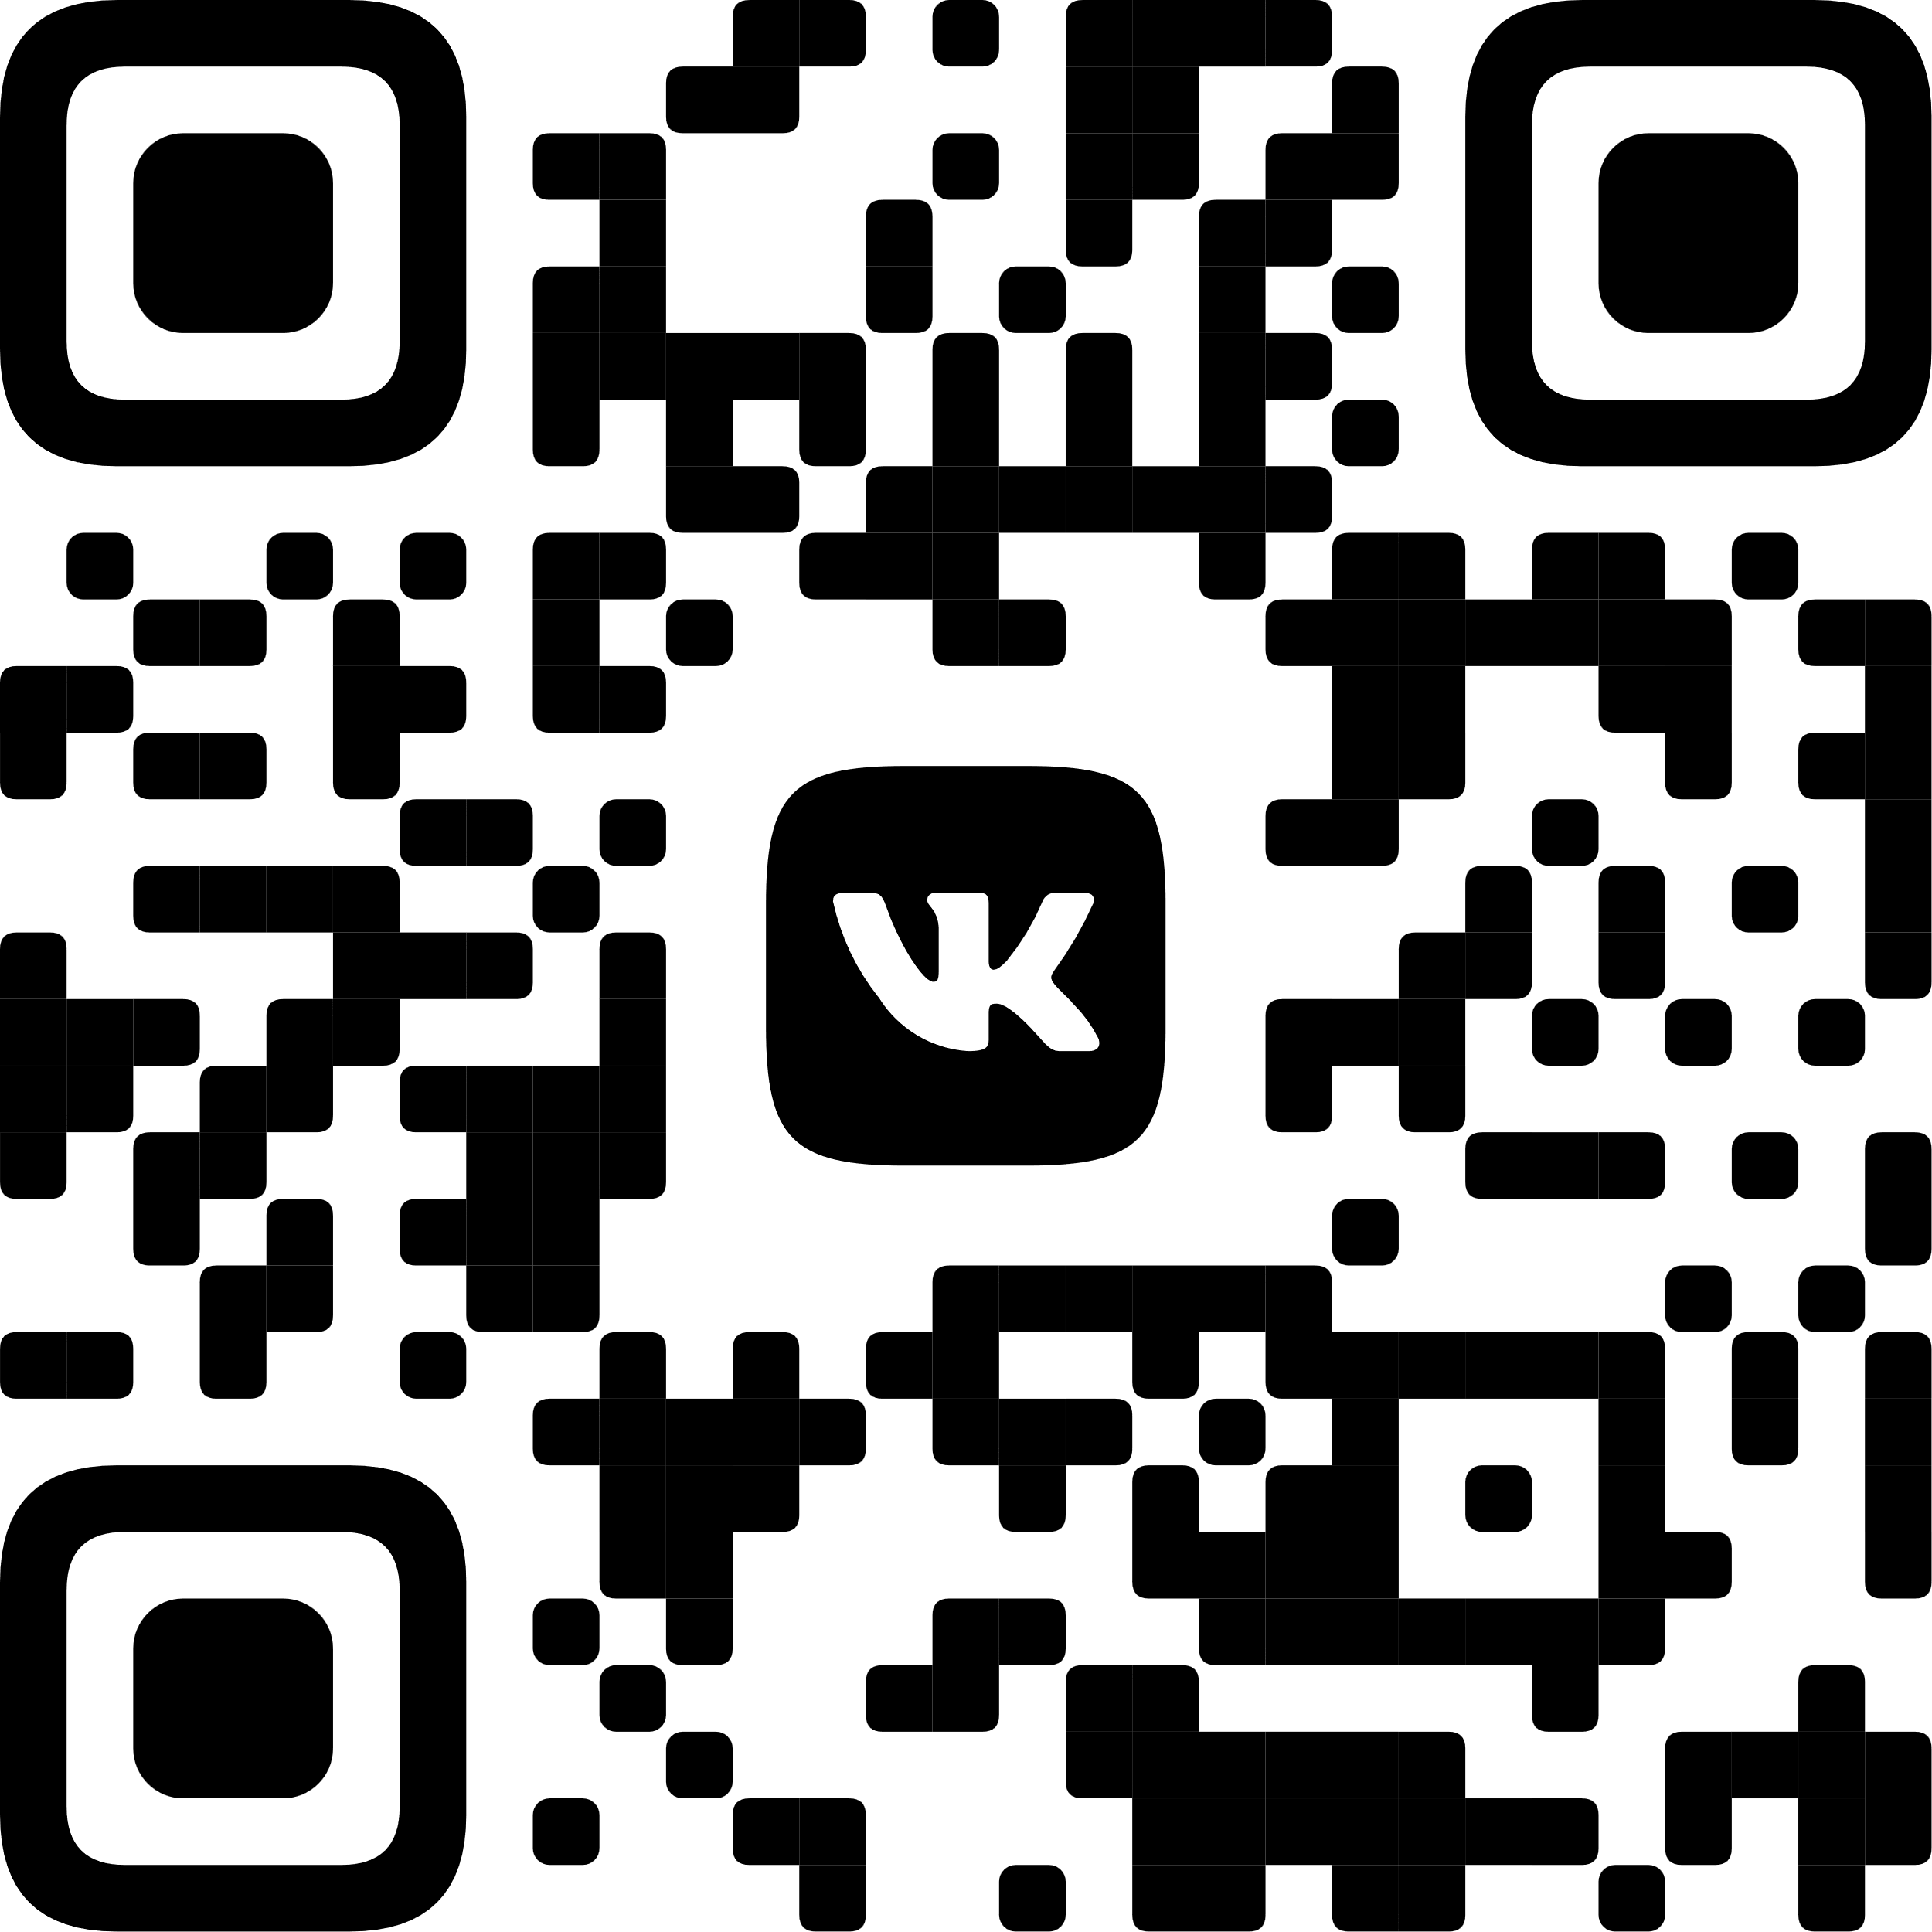









Educational programmes
(taught in Russian)
Higher School of Physical Education and Sports
Higher School of Humanities
Higher Oil School
49.03.01 Physical Education
Master’s,
Postgraduate’s programmes
44.03.02 Psychological and Pedagogic Education
44.03.03 Special Education (Defectology)
42.03.02 Journalism
45.03.02 Linguistics
45.03.01 Philology
Master’s, Postgraduate’s programmes
04.03.01 Chemistry
21.03.01 Oil and Gas Engineering
21.05.06 Oil and Gas Equipment and Technology
21.05.02 Applied Geology
Master’s, Postgraduate’s programmes
Higher School of Law
40.04.01 Law
Master’s, Postgraduate’s programmes
Higher School of Digital Technologies
09.03.04 Software Engineering
(taught in English)
Polytechnic School
Higher School of Digital Economy
Higher Ecological School
Higher School of Digital Technologies
08.03.01 Construction
13.03.02 Electric Power Engineering and Electrical Engineering
20.03.01 Technosphere Safety
27.03.05 Innovation Studies
Master’s,
Postgraduate’s programmes
38.03.01 Economics
38.03.02 Management
Master’s,
Postgraduate’s
programmes
05.03.06 Ecology and Environmental Management
05.03.03 Cartography and Geoinformatics
Master’s, Postgraduate’s programmes
09.03.01 Computer Science and Computer Engineering
09.03.04 Software Engineering
10.03.01 Information Security
Master’s, Postgraduate’s programmes

Slide 10
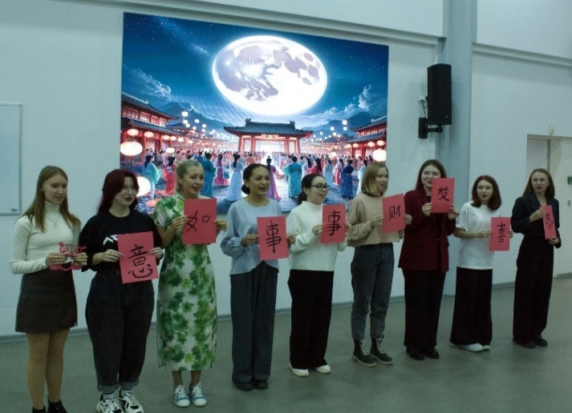
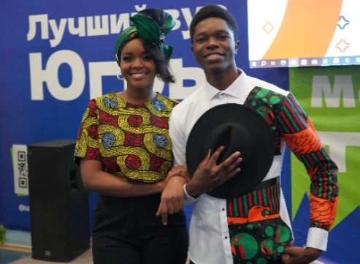
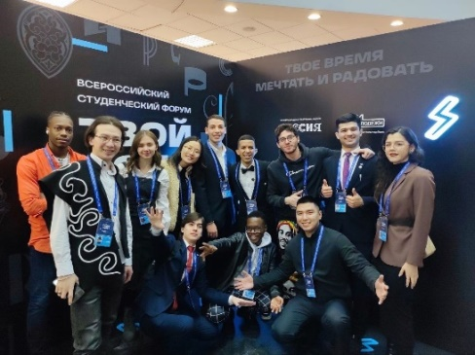
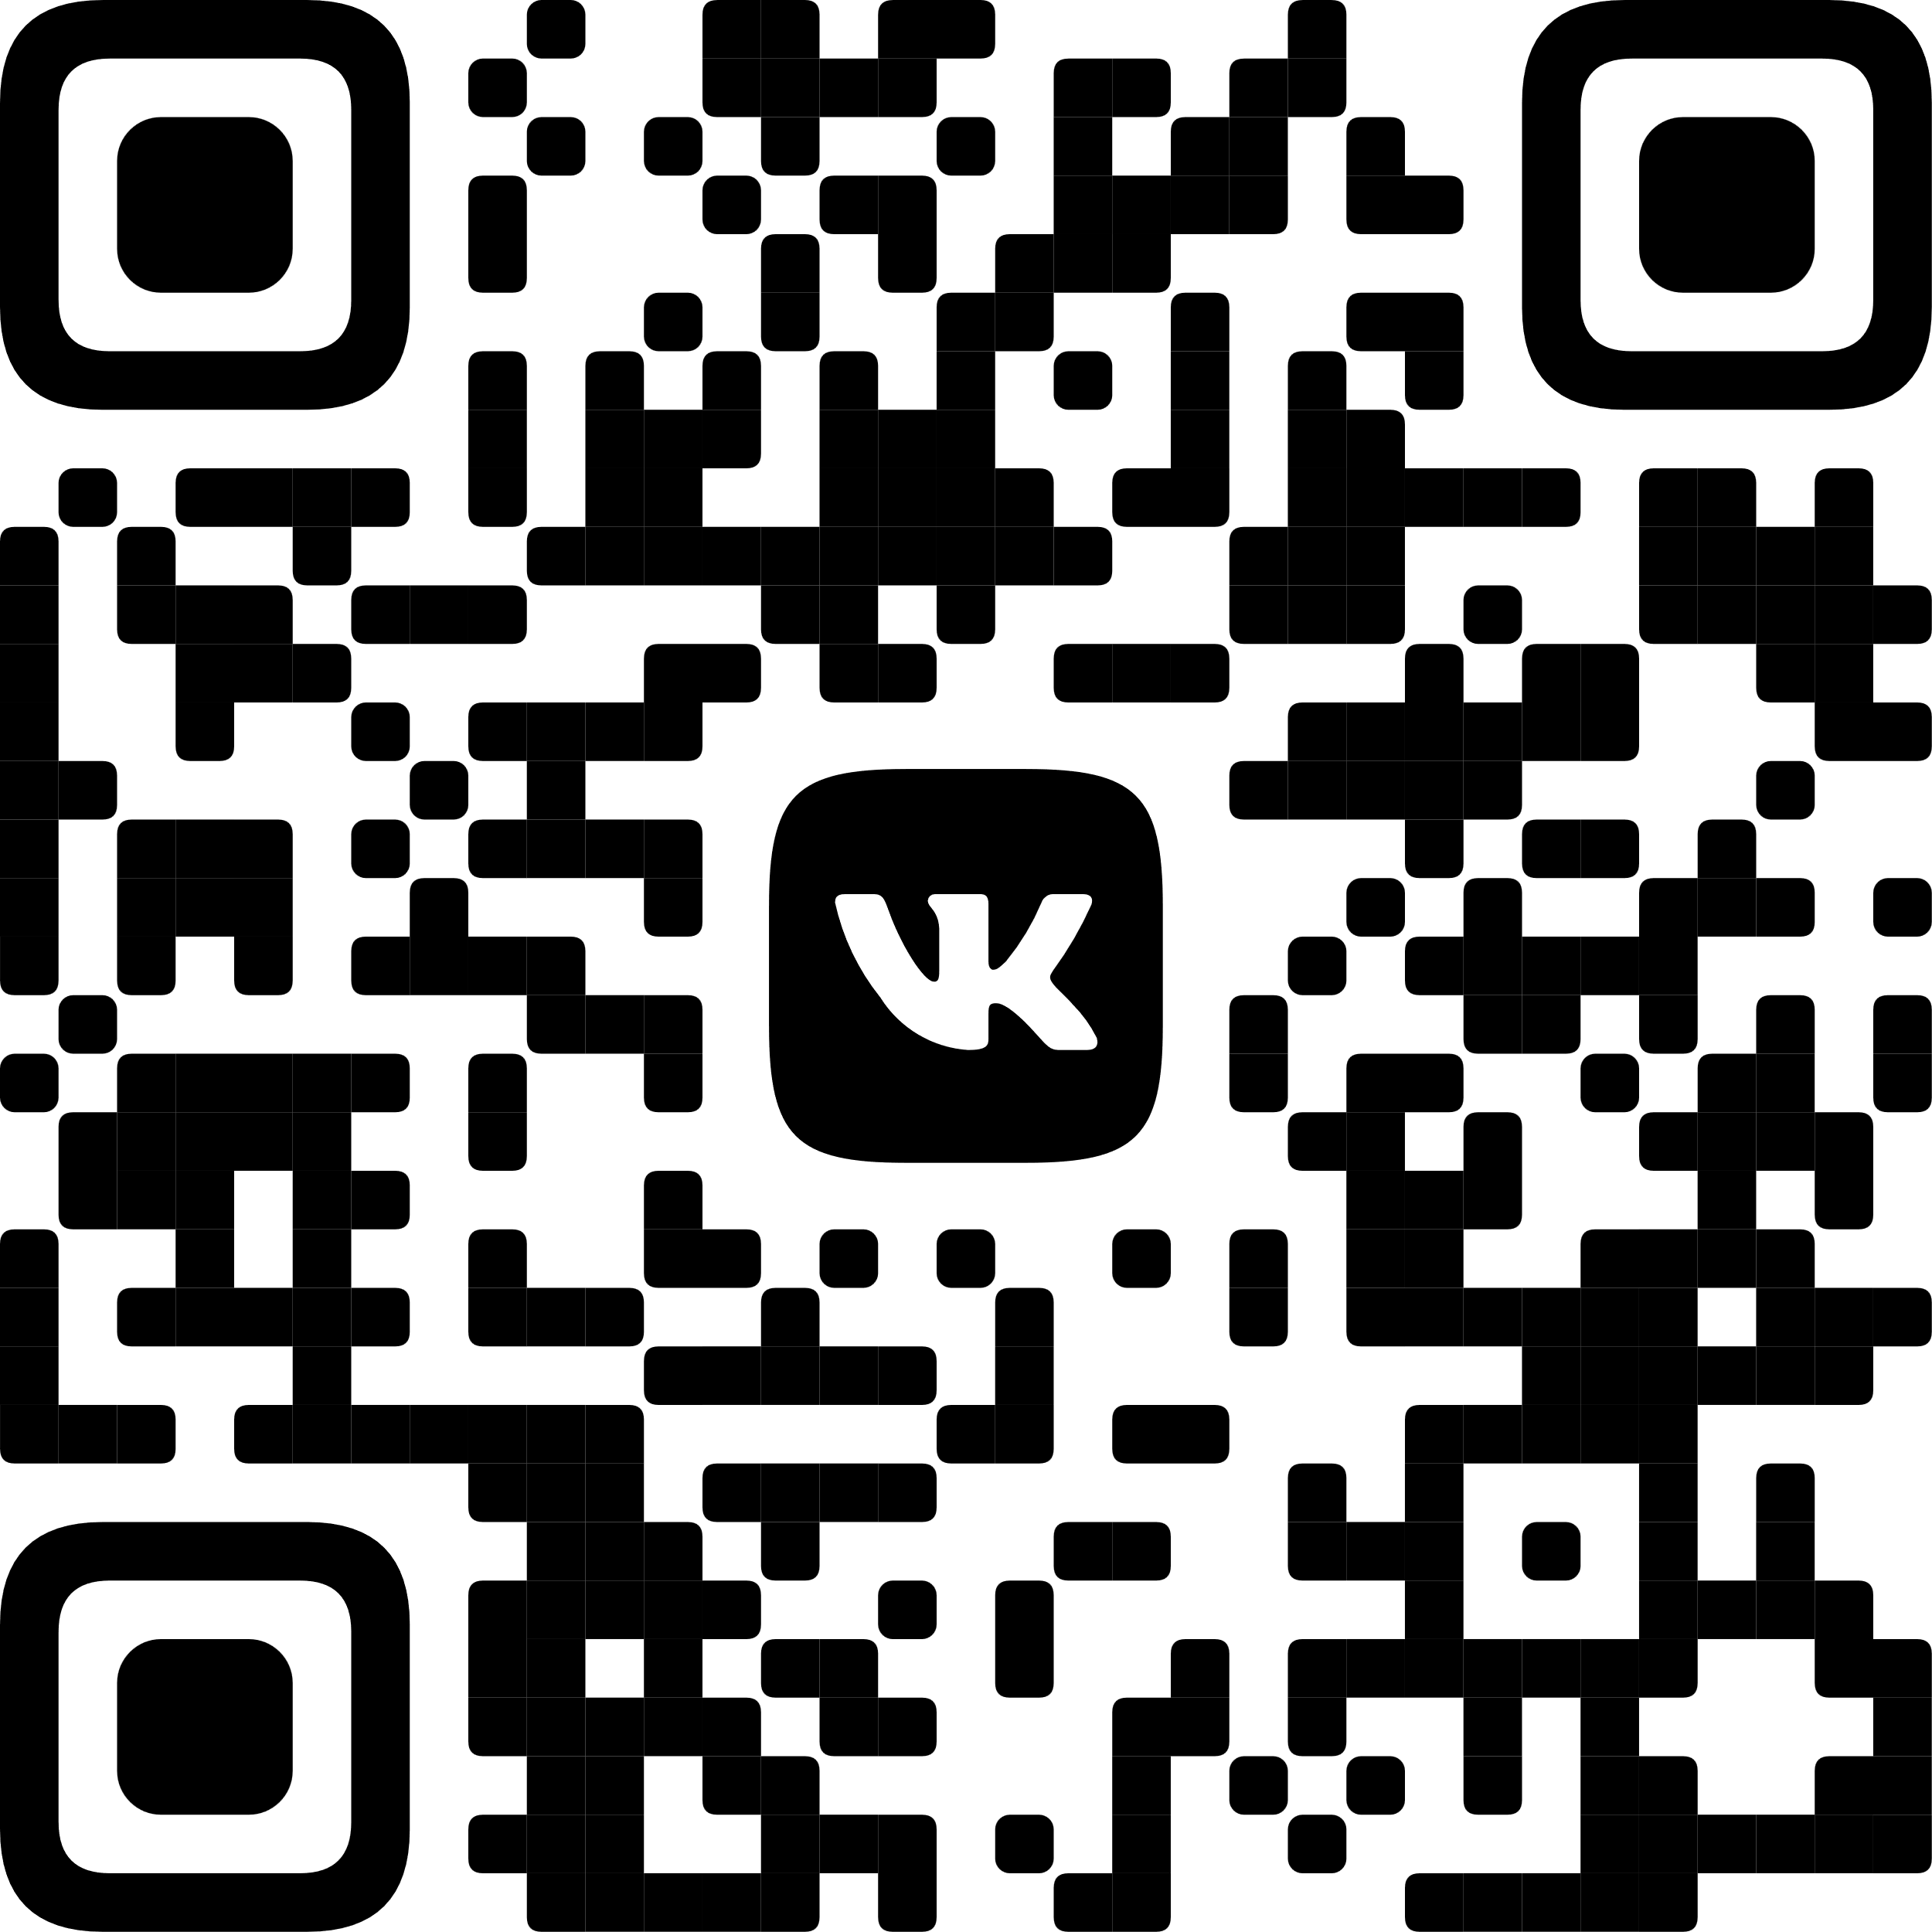

Language Centres
Preparatory Department
Application period：April 1－
August 15
Start of studies：October 1
Duration： 1 year，2160 hours
(including 1120 classroom hours)
Centre for Chinese Language and Culture
YuDao Centre brings together people interested in studying Chinese Language, culture, customs and traditions
Russian as Foreign Language (5 profiles）
Humanities
Medical
Engineering
Natural Science
Economics
Contacts:
ugrasu.international@gmail.com
+79825544517（WhatsApp）

Slide 11
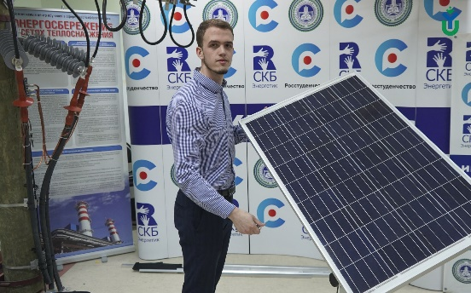
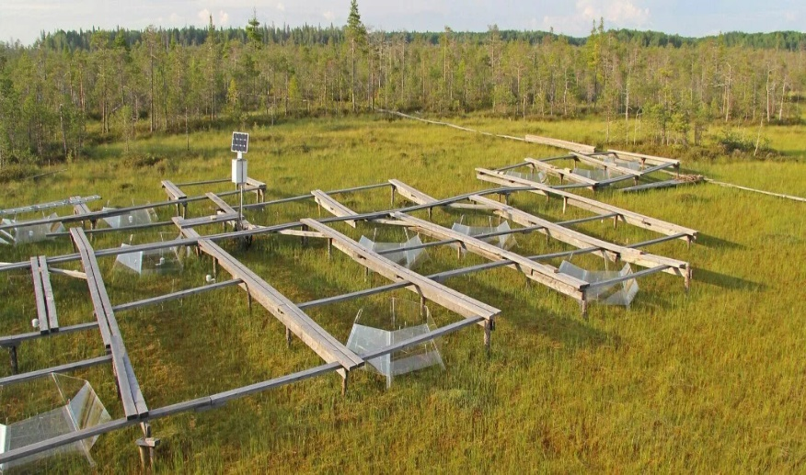

🔬 Key research areas of Yugra State University
Yugra State University is a leading regional university whose research priorities are closely tied to the strategic needs of the Khanty-Mansiysk Autonomous Okrug – Yugra, particularly the energy and ecological sectors of the Russian North and Arctic.
⚡ Energy and Arctic Technologies
Reliable and high-quality power supply for the Far North and Arctic regions
Digitalization of the power industry
Resource-saving technologies for hydrocarbon development
High-tech equipment for the oil and gas sector
Four major projects underway in electric power engineering
🌿 Ecology, Climate Change, and Carbon Monitoring
Pioneer in digital carbon monitoring and operator of a carbon polygon
Environmental dynamics and global climate change
Role of bogs in carbon cycles
Mycorrhizal biotechnology for reforestation and climate projects
💻 Information Technology and Mathematical Modeling
Nonlinear dynamics and process control
Mathematical modeling for natural science and socio-economic problems
IT solutions for complex technical and natural systems

Slide 12
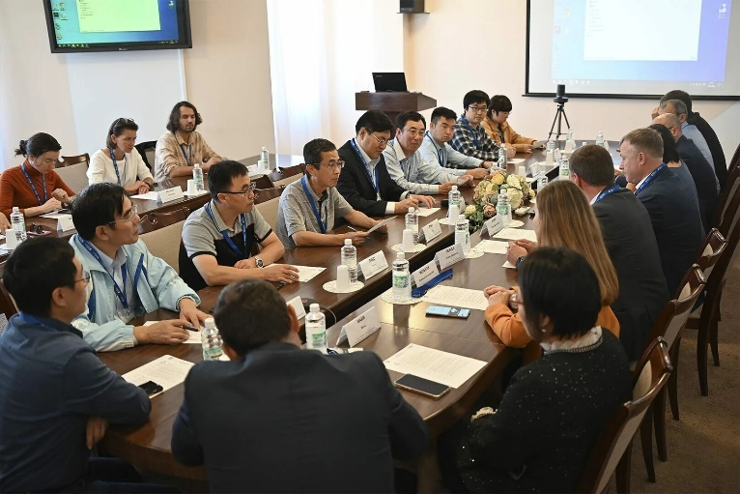
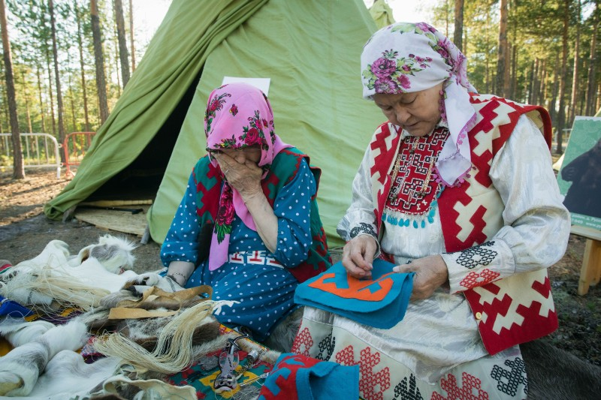
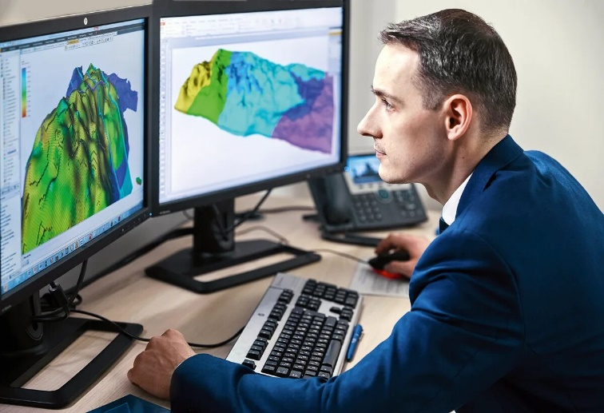
🔬 Key research areas of Yugra State University
⚖️ Social, Legal, and Economic Research
Institutional transformation in resource-producing regions under digitalization
Effective law enforcement and human rights activities in northern territories
Regional linguistic studies
📚 Preservation of Indigenous Cultures
Preservation and development of Khanty and Mansi socio-cultural traditions
Collection and processing of dialect materials
Research in Finno-Ugric studies
Translation and publication of the Mansi epic
🛢Petrochemistry, Geology, and Geoecology
Strong scientific schools in petrochemistry and geology
Research aligned with the region's resource extraction profile
Geoecological assessment of oil and gas operations

Slide 13
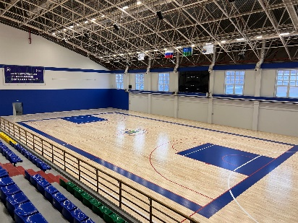
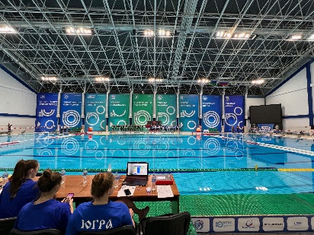
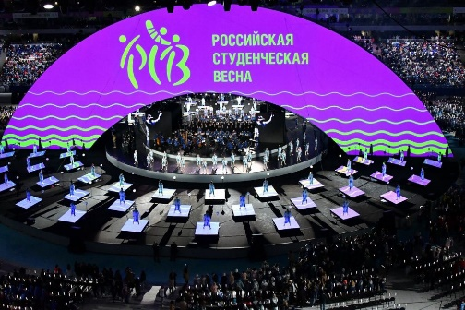
Student and Sports Life
Events
Cultural
Sports
Patriotic
Volunteering
Sports Complex
7 sport grounds
50 m pool
8 sports sections
YuSU Student Sports Club “SEVER” - a team of active students promoting physical education and sports among young people as an integral part of harmonious human development and one of the most important spheres of youth life.
Students can also take part in federal and regional events, such as scientific forums, volunteer activities, creative competitions and sports competitions.

Slide 14
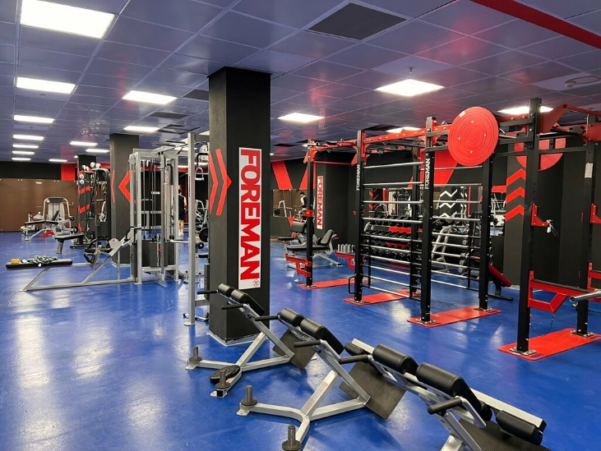
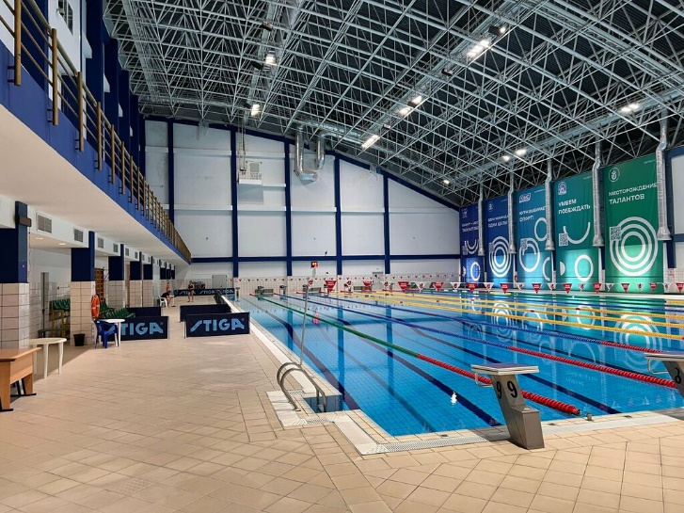
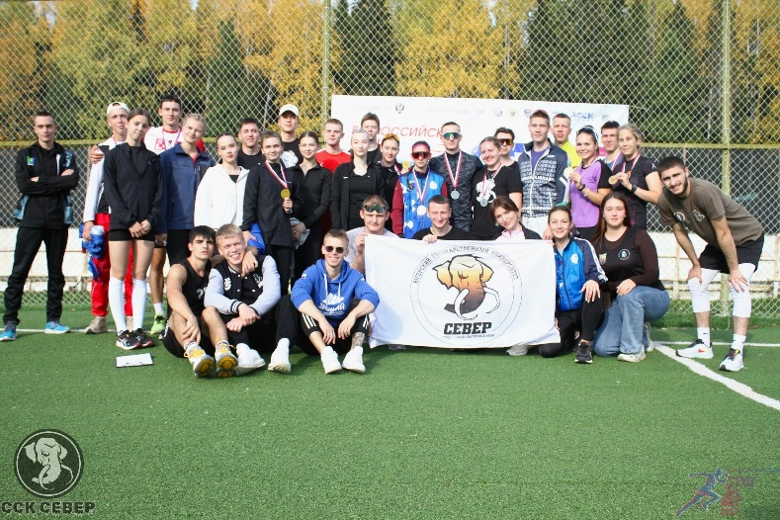
Sports Complex
7 sport grounds 50 m sports pool 8 sections
Sections: swimming, football, volleyball, fitness, wrestling

Slide 15
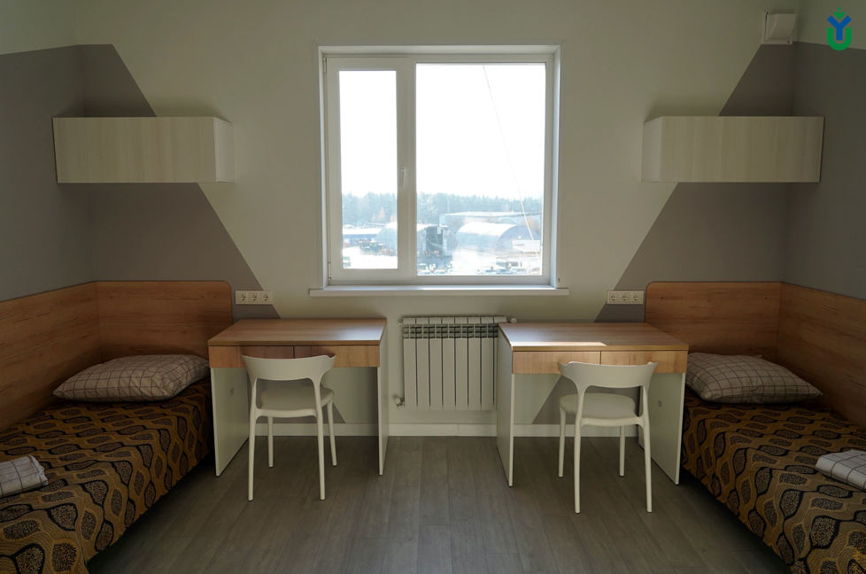
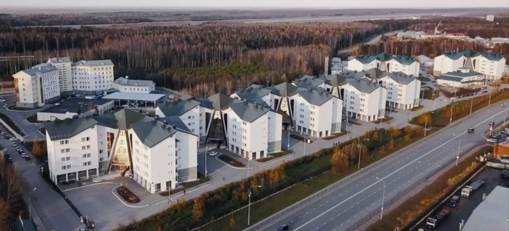
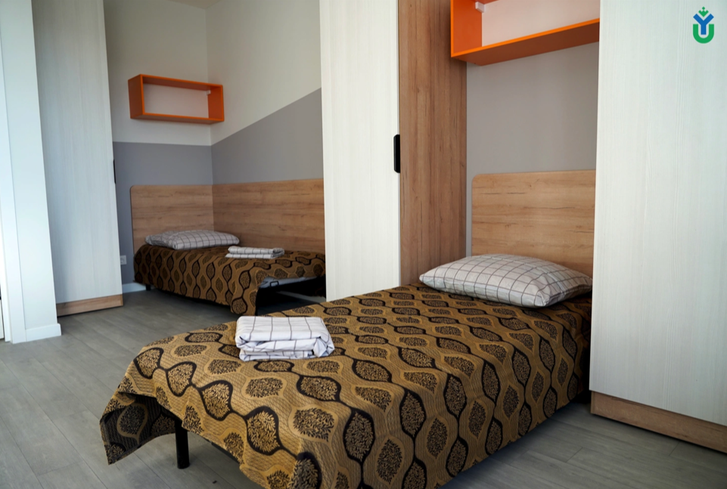
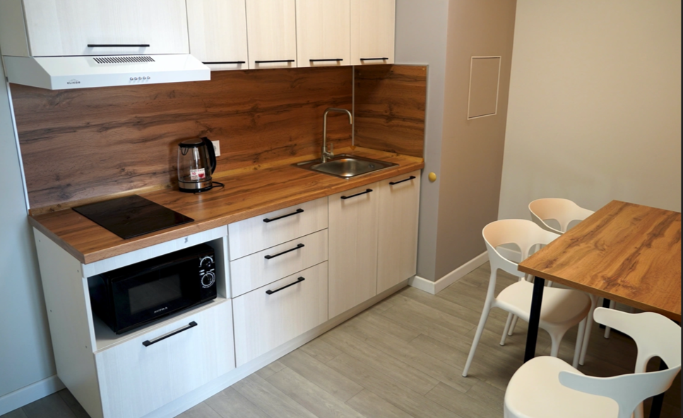
Dormitories
8
buildings
Amenities:
Block-type apartment with private bathroom. Separate kitchen with electric stove. Fully furnished.
2 600
Within walking distance:
beds
Sports stadium
Pool
Shops
Public transport
Hospital

Slide 16

See you at
YuSU！
Contacts：
priem@ugrasu.ru、ugrasu.ru、
vk.com/abit_ugrasu
+7 9825544517 (whatsapp, telegram）

